Slide 1
Binomial Heap
Ref: CLRS 2nd edition
Prepared by
Preetom Saha Arko

Slide 2
Union of Two Heaps
Runtime using traditional binary heap?
O(n)
Runtime using binomial heap : O(lgn)
Merges two binomial heaps with a total of n elements
Various types of mergeable heaps:
Binomial heap
Fibonacci heap
Leftist tree
Pairing heap
Skew heap

Slide 3
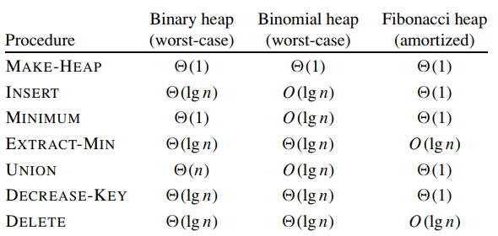
Comparison of Runtime

Slide 4
Operations We Want
MAKE-HEAP() creates and returns a new heap containing no elements.
INSERT(H, x) inserts node x, whose key field has already been filled in, into heap H.
MINIMUM(H) returns a pointer to the node in heap H whose key is minimum.
EXTRACT-MIN(H) deletes the node from heap H whose key is minimum, returning a pointer to the node.
UNION(H1, H2) creates and returns a new heap that contains all the nodes of heaps H1 and H2. Heaps H1 and H2 are “destroyed” by this operation.
DECREASE-KEY(H, x, k) assigns to node x within heap H the new key value k, which is assumed to be no greater than its current key value.
DELETE(H, x) deletes node x from heap H.

Slide 5
Assumptions
Binary heaps, binomial heaps, and Fibonacci heaps are all inefficient in their support of the operation SEARCH; it can take a while to find a node with a given key.
For this reason, operations such as DECREASE-KEY and DELETE that refer to a given node require a pointer to that node as part of their input.

Slide 6
Ordered Tree
An ordered tree is a rooted tree in which the children of each node are ordered.
That is, if a node has k children, then there is a first child, a second child, . . . , and a kth child.

Slide 7
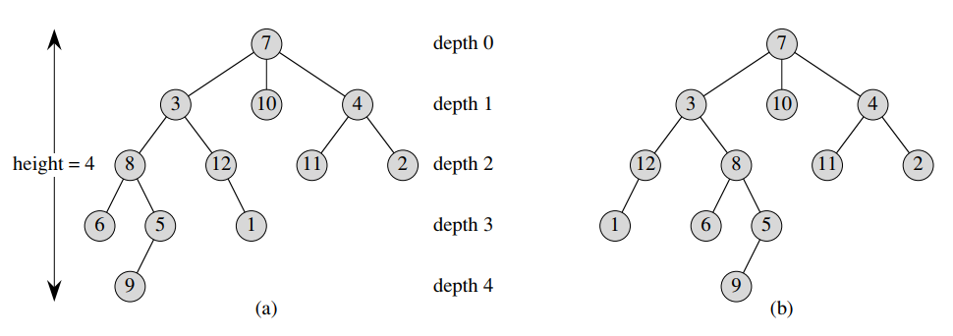
Ordered Tree (contd.)
The two trees are different when considered to be ordered trees, but the same when considered to be just rooted trees.

Slide 8
Binomial Tree
The binomial tree B_{k} is an ordered tree defined recursively.
The binomial tree B₀ consists of a single node.
The binomial tree B_{k} consists of two binomial trees B_{k−1} that are linked together: the root of one is the leftmost child of the root of the other.

Slide 9
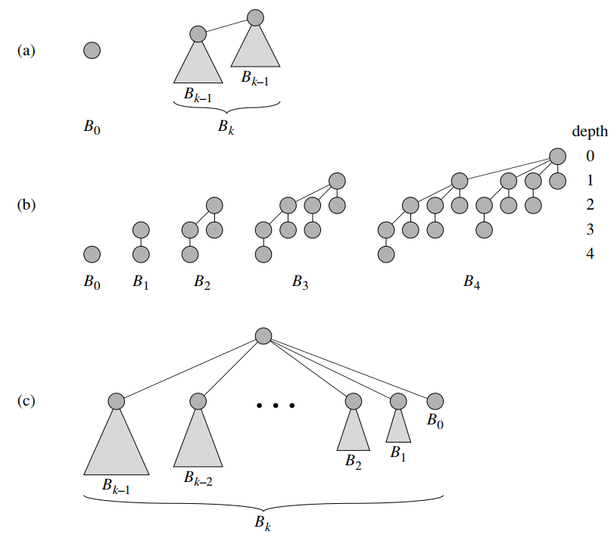
Binomial Tree

Slide 10
Properties of Binomial Trees
For the binomial tree B_{k},
there are 2^{k} nodes,
the height of the tree is k,
there are exactly ^{k}C_{i} nodes at depth i for i = 0, 1, . . . , k, and
the root has degree k, which is greater than that of any other node; moreover if the children of the root are numbered from left to right by k − 1, k − 2, . . . , 0, child i is the root of a subtree B_{i}.

Slide 11
Binomial Tree
The maximum degree of any node in an n-node binomial tree is lg n.
The term “binomial tree” comes from property 3, since the terms ^{k}C_{i} are the binomial coefficients.

Slide 12
Binomial Heap
A binomial heap H is a set of binomial trees that satisfies the following binomial heap properties.
Each binomial tree in H obeys the min-heap property: the key of a node is greater than or equal to the key of its parent. We say that each such tree is min-heap-ordered.
For any nonnegative integer k, there is at most one binomial tree in H whose root has degree k.

Slide 13
Properties of Binomial Heap
Each binomial tree in H obeys the min-heap property: the key of a node is greater than or equal to the key of its parent. We say that each such tree is min-heap-ordered.
So the root of a min-heap-ordered tree contains the smallest key in the tree.
Since a binomial heap is min-heap-ordered, the minimum key must reside in a root node.

Slide 14
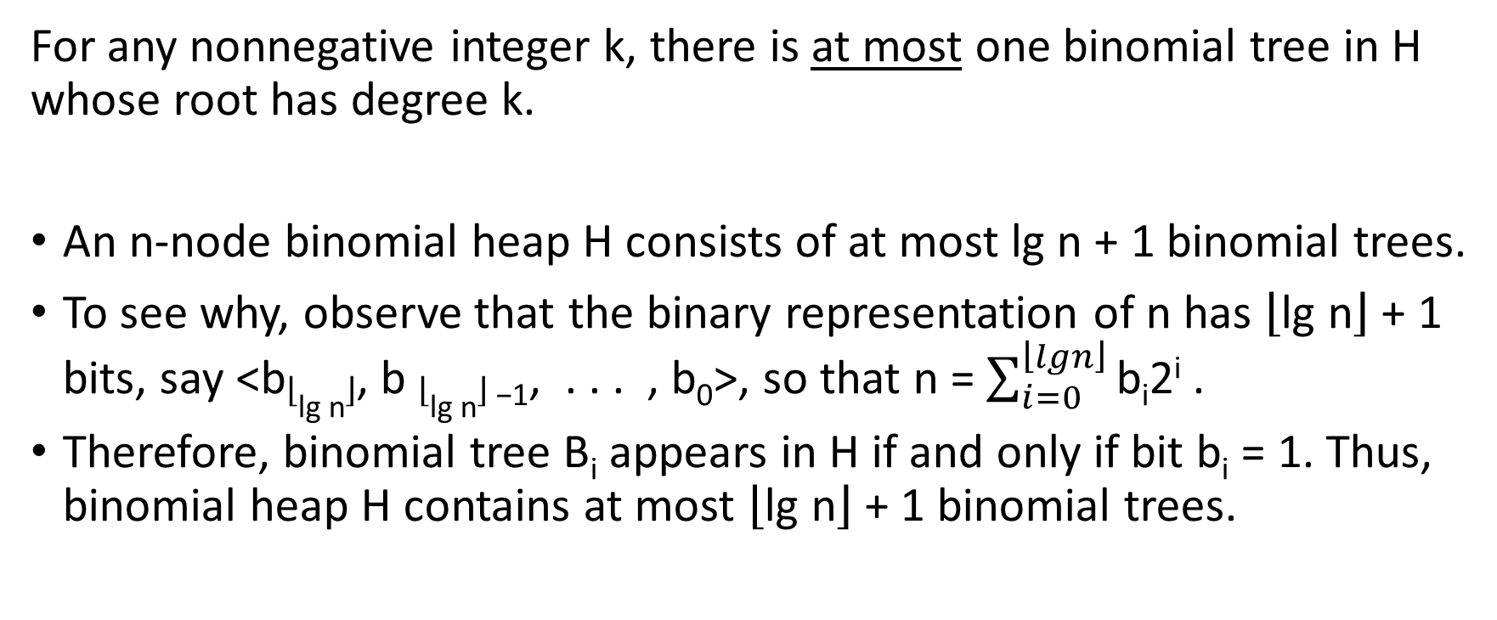
Properties of Binomial Heap (contd.)
For any nonnegative integer k, there is at most one binomial tree in H whose root has degree k.
An n-node binomial heap H consists of at most lg n + 1 binomial trees.
To see why, observe that the binary representation of n has $\left\lfloor \text{lg} \text{n}\right\rfloor$ + 1 bits, say <b$\left\lfloor \text{lg} \text{n}\right\rfloor$, b $\left\lfloor \text{lg} \text{n}\right\rfloor$₋₁, . . . , b₀>, so that n = $\sum_{i=0}^{\left\lfloor lgn\right\rfloor }{\text{b}\text{i}\text{2}\text{i}}$.
Therefore, binomial tree B_{i} appears in H if and only if bit b_{i} = 1. Thus, binomial heap H contains at most $\left\lfloor \text{lg} \text{n}\right\rfloor$ + 1 binomial trees.

Slide 15
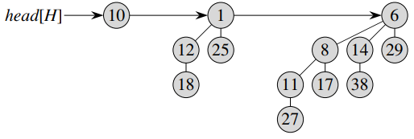
Example Binomial Heap
A binomial heap H with 13 nodes.
The binary representation of 13 is <1101>, and H consists of min-heap-ordered binomial trees B₃, B₂, and B₀, having 8, 4, and 1 nodes respectively, for a total of 13 nodes.

Slide 16
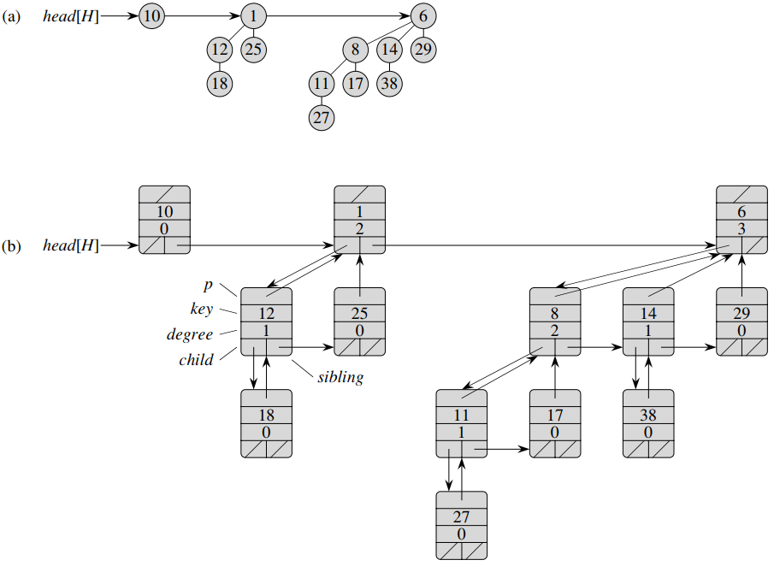
How to Represent A Binomial Heap

Slide 17
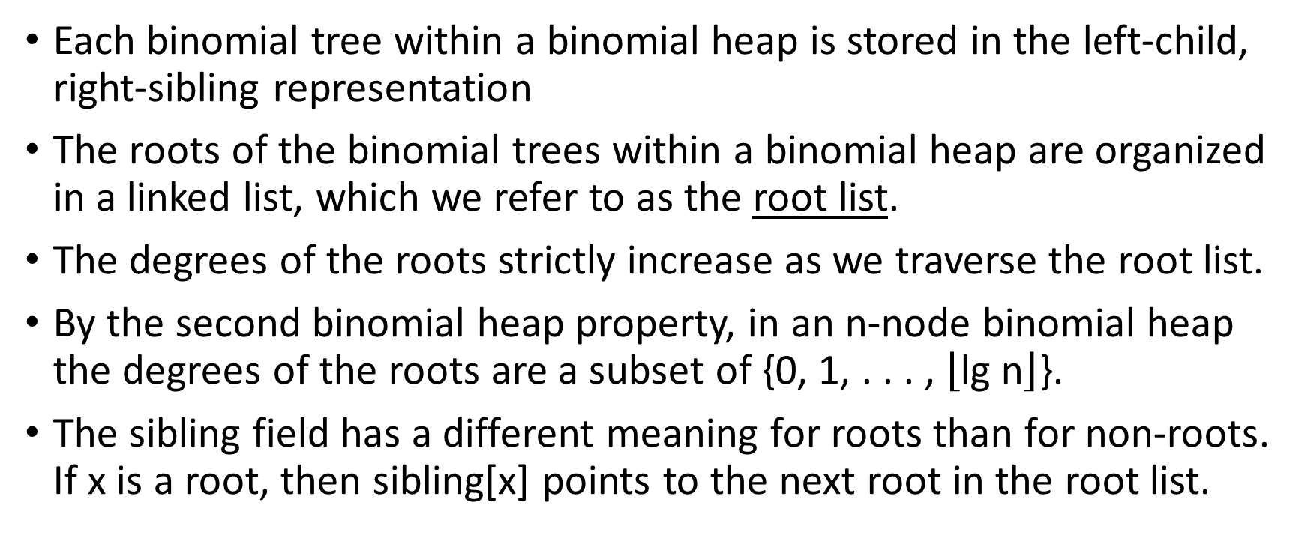
Representation of A Binomial Heap
Each binomial tree within a binomial heap is stored in the left-child, right-sibling representation
The roots of the binomial trees within a binomial heap are organized in a linked list, which we refer to as the root list.
The degrees of the roots strictly increase as we traverse the root list.
By the second binomial heap property, in an n-node binomial heap the degrees of the roots are a subset of {0, 1, . . . , $\left\lfloor \text{lg} \text{n}\right\rfloor$}.
The sibling field has a different meaning for roots than for non-roots. If x is a root, then sibling[x] points to the next root in the root list.

Slide 18
Representation of A Binomial Heap (contd.)
A given binomial heap H is accessed by the field head[H], which is simply a pointer to the first root in the root list of H.
If binomial heap H has no elements, then head[H] = NIL.

Slide 19
Creating A New (empty) Binomial Heap
To make an empty binomial heap, the MAKE-BINOMIAL-HEAP procedure simply allocates and returns an object H, where head[H] = NIL.
The running time is Θ(1).

Slide 20
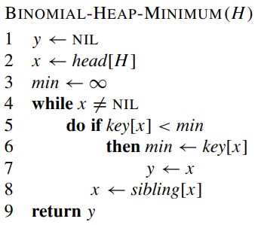
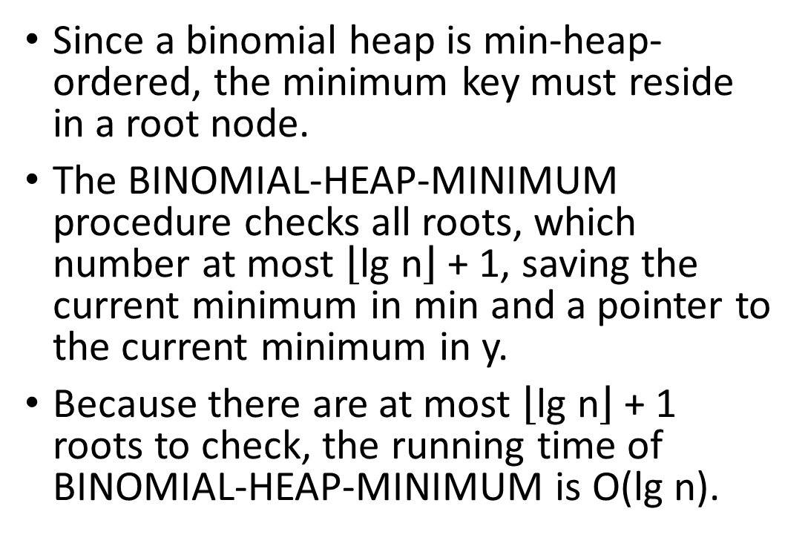
Finding Minimum Key
Since a binomial heap is min-heap-ordered, the minimum key must reside in a root node.
The BINOMIAL-HEAP-MINIMUM procedure checks all roots, which number at most $\left\lfloor \text{lg} \text{n}\right\rfloor$+ 1, saving the current minimum in min and a pointer to the current minimum in y.
Because there are at most $\left\lfloor \text{lg} \text{n}\right\rfloor$+ 1 roots to check, the running time of BINOMIAL-HEAP-MINIMUM is O(lg n).

Slide 21
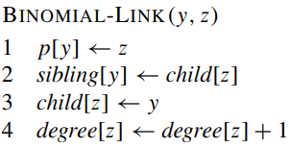
Uniting Two Binomial Heaps
BINOMIAL-HEAP-UNION procedure repeatedly links binomial trees whose roots have the same degree.
This procedure links the B_{k−1} tree rooted at node y to the B_{k−1} tree rooted at node z; that is, it makes z the parent of y.
Node z thus becomes the root of a B_{k} tree.

Slide 22
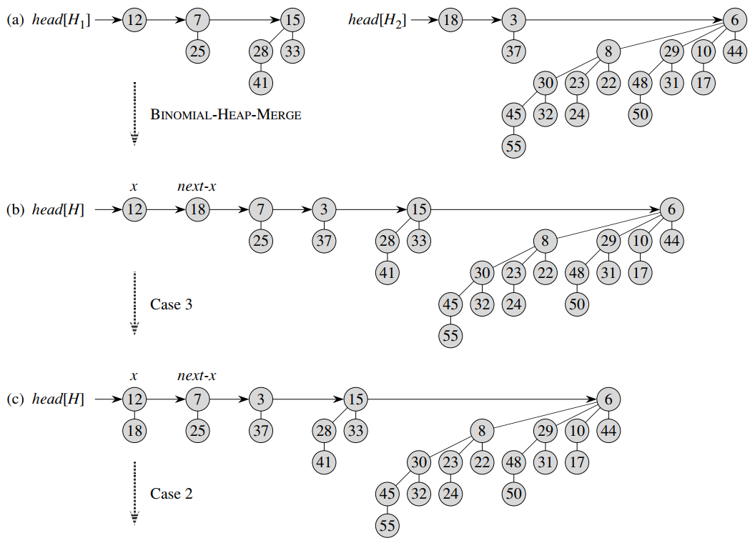
BINOMIAL-HEAP-UNION(H1, H2)

Slide 23
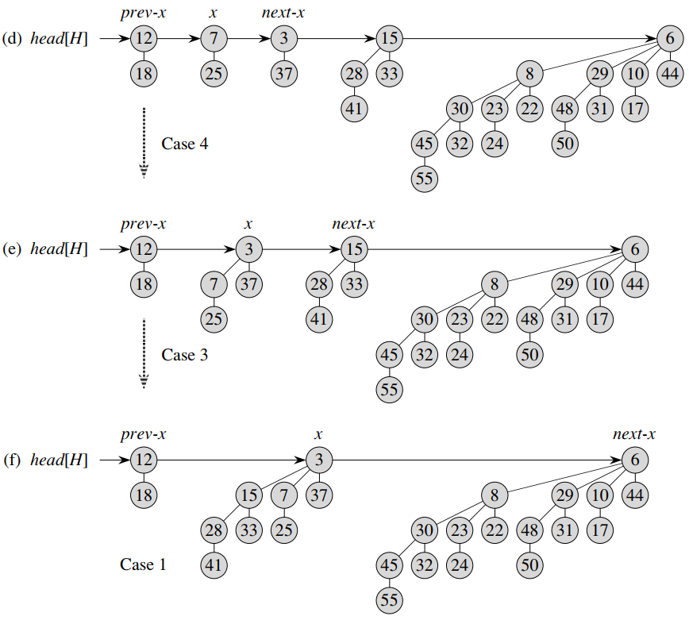
BINOMIAL-HEAP-UNION(H1, H2)

Slide 24
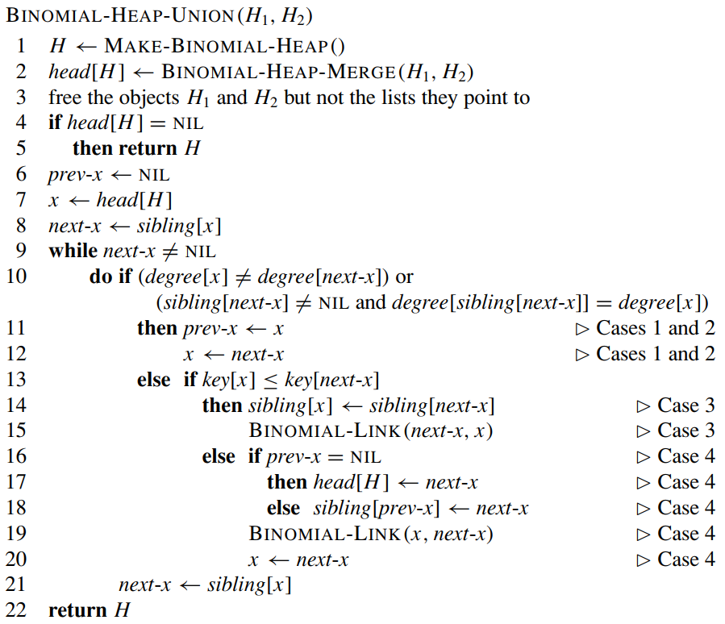
BINOMIAL-HEAP-UNION(H1, H2)

Slide 25
BINOMIAL-HEAP-UNION (contd.)
The root lists of H1 and H2 are sorted by strictly increasing degree, and BINOMIAL-HEAP-MERGE returns a root list H that is sorted by monotonically increasing degree.
Initially, there are at most two roots on the root list H of a given degree.
BINOMIAL-HEAP-MERGE guarantees us that if two roots in H have the same degree, they are adjacent in the root list.
During the execution of BINOMIAL-HEAP-UNION, there may be three roots of a given degree appearing on the root list H at some time.
We decide whether to link x and next-x based on their degrees and possibly the degree of sibling[next-x].

Slide 26
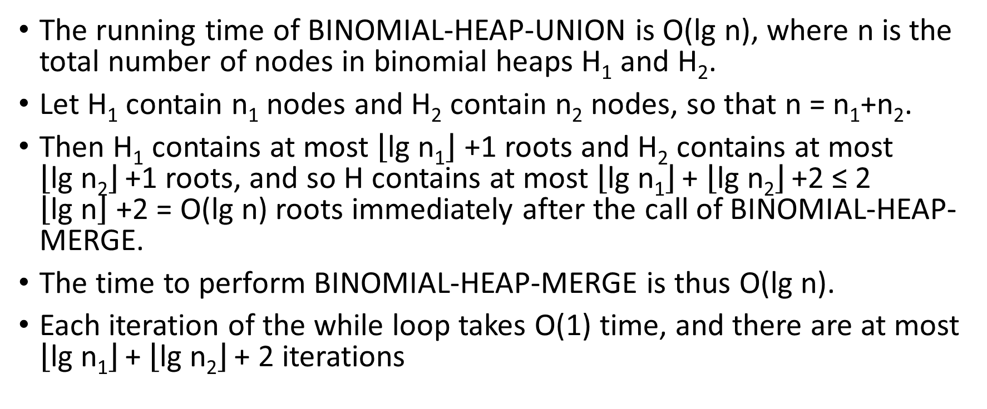
Runtime of BINOMIAL-HEAP-UNION
The running time of BINOMIAL-HEAP-UNION is O(lg n), where n is the total number of nodes in binomial heaps H₁ and H₂.
Let H₁ contain n₁ nodes and H₂ contain n₂ nodes, so that n = n₁+n₂.
Then H₁ contains at most $\left\lfloor \text{lg} \text{n}\text{1}\right\rfloor$+1 roots and H₂ contains at most $\left\lfloor \text{lg} \text{n}\text{2}\right\rfloor$+1 roots, and so H contains at most $\left\lfloor \text{lg} \text{n}\text{1}\right\rfloor$+ $\left\lfloor \text{lg} \text{n}\text{2}\right\rfloor$+2 ≤ 2 $\left\lfloor \text{lg} \text{n}\right\rfloor$+2 = O(lg n) roots immediately after the call of BINOMIAL-HEAP-MERGE.
The time to perform BINOMIAL-HEAP-MERGE is thus O(lg n).
Each iteration of the while loop takes O(1) time, and there are at most $\left\lfloor \text{lg} \text{n}\text{1}\right\rfloor$+ $\left\lfloor \text{lg} \text{n}\text{2}\right\rfloor$+ 2 iterations

Slide 27
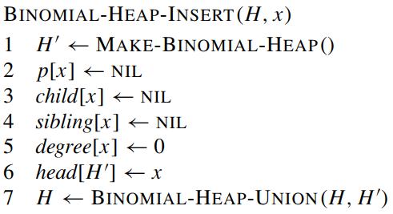
Inserting A Node
The procedure simply makes a one-node binomial heap H’ in O(1) time and unites it with the n-node binomial heap H in O(lg n) time

Slide 28
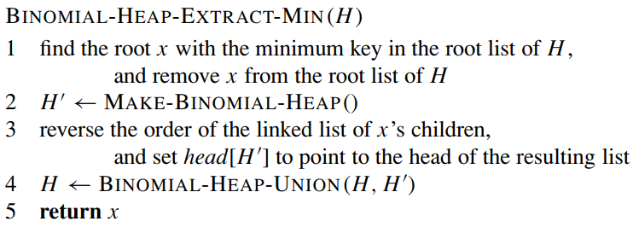
Extracting The Node with Minimum Key
If x is the root of a B_{k}-tree, then x’s children, from left to right, are roots of B_{k−1} , B_{k−2} , . . . , B₀-trees.

Slide 29
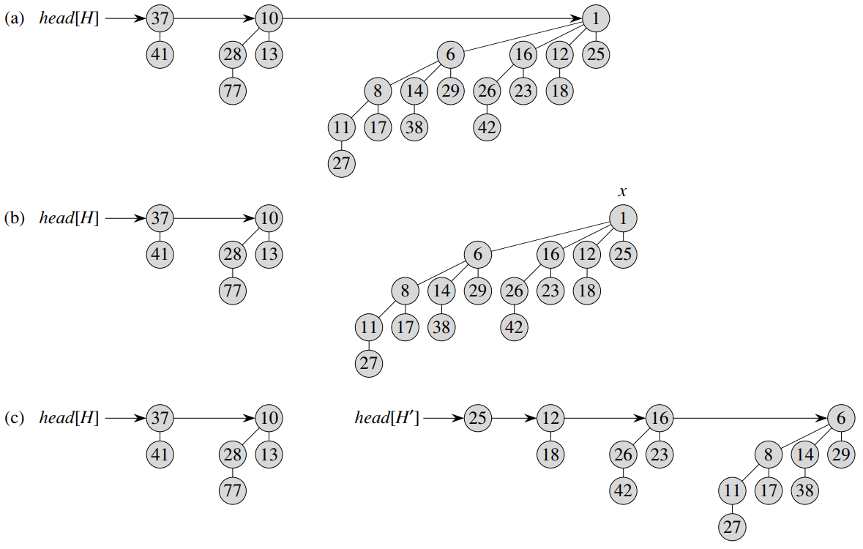
Steps of Extract Min

Slide 30
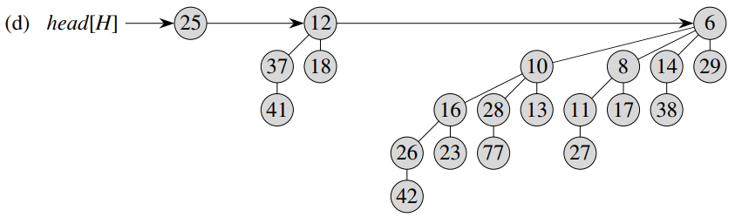
Resulting Binomial Heap

Slide 31
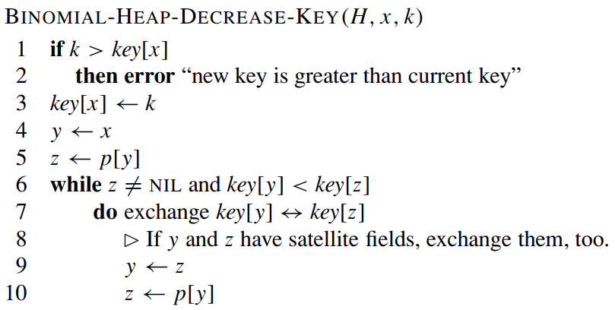
Decrease Key

Slide 32
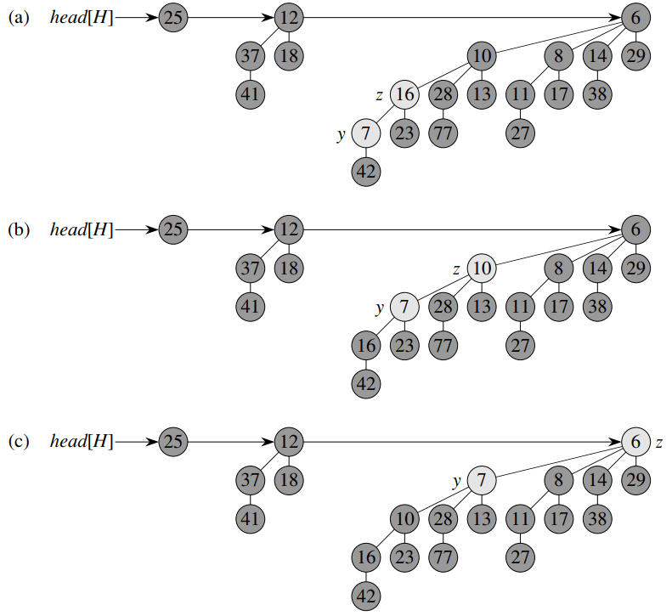
Steps of Decrease Key

Slide 33

Runtime of BINOMIAL-HEAP-DECREASE-KEY
The BINOMIAL-HEAP-DECREASE-KEY procedure takes O(lg n) time.
The maximum depth of x is $\left\lfloor \text{lg} \text{n}\right\rfloor$, so the while loop of lines 6–10 iterates at most $\left\lfloor \text{lg} \text{n}\right\rfloor$times.

Slide 34
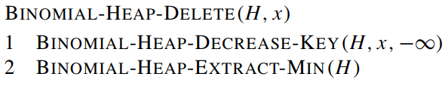
Deleting A Key
The BINOMIAL-HEAP-DELETE procedure takes O(lg n) time.

